Slide 1


AI Engineer Challenge
A Smart, Explainable, and Real-Time GenAI Assistant Built for Customer Support.
Subrata Roy, Senior Data Scientist
Date: 21.04.2025

Slide 2
Agenda
Problem Statement
Objective
Architecture Overview
Dataset
Model Choice
Retrieval Workflow
Prompt Engineering
RAG Implementation
9. Evaluation Strategy
10. API Deployment
11. Conclusion & Learning

Slide 3

Problem Statement
High volume of support requests
Knowledge silos
Information scattered across systems
Extensive manual effort, slow resolutions
Consistency challenges
Variable response quality to customers

Slide 4

Objective
Automate customer query handling
Enhance knowledge retrieval
Improve customer satisfaction
Reduce manual workload
Quick, precise information access
Consistent, high-quality support

Slide 5
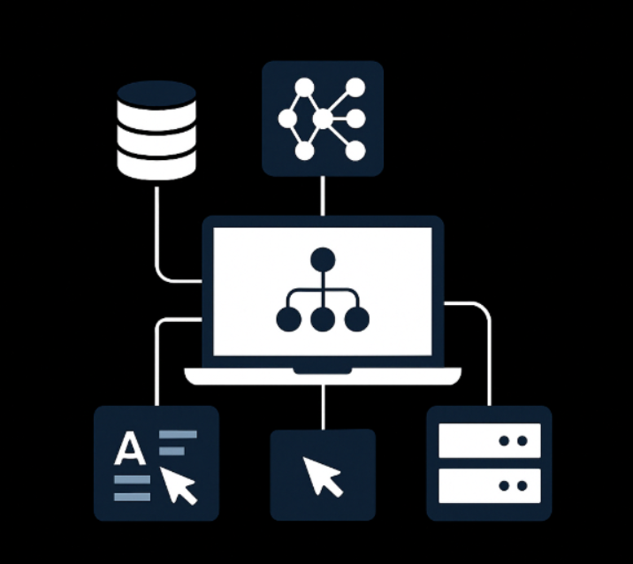
Architecture Overview
LLM
Core Components
Data Ingestion
Load The Dataset
Embedding & Vector Store
Language Model
Embedding
Retrieval Layer
Integration
APIs for support platforms
Real-time query processing
Prompt
API
Vector DB

Slide 6
Dataset
Source Types
Volume
Twitter Support Replies
~1000 Sample Records From 945k Tweets
Internal Knowledge Base
Preprocessing
Lowercasing and punctuation cleanup
Tokenization
Embedding generation

Slide 7

Model Choice
Foundation Model
Embedding Model
Mistral-7B-Instruct for natural language understanding
MiniLM Used for dense vector-based semantic search
RAG
Top-k document retrieval from ChromaDB Domain-specific
context injected into prompt

Slide 8




Retrieval Workflow
Input processing
Normalize and parse query
Vector search
Find relevant documents in vector store
Context construction
Aggregate top matches as context
Response generation
Language model crafts answer

Slide 9

Prompt Engineering
Structured Prompts
Generation Prompts
Designed for generation and automated evaluation
Use tags like [INST] <> Context and Query
Evaluation Prompts
Automated, follow similar structured template

Slide 10
Retrieval-Augmented Generation (RAG) Implementation
Flow Overview
Technologies Used
User Query
ChromaDB vector store
Vector DB retrieves Top-3 Docs
SentenceTransformer embeddings
LLM generates Response
Mistral LLM for response

Slide 11
Evaluation Strategy
Dual Evaluation
Criteria
LLM-as-a-judge
Relevance
Manual human scoring
Correctness
Conciseness
Fluency
Output Format
JSON with detailed scores per criterion

Slide 12

API Deployment
Tech Stack
Endpoints
Schema
FastAPI web framework
/generate_response
Visual request-response structure for clarity
ngrok for secure tunneling
/submit_scores

Slide 13
Key Conclusions
Built
Successes
GenAI assistant fully operable on Google Colab
Effective prompt design and model evaluation
Lessons Learned
Context quality critical for response accuracy

